Slide 1
Grammar & Basics Week 3: Nouns

Slide 2
Forming the plural of nouns: Always add s? (…or is it more complex than that?)

Slide 3
Spelling Plurals
Words that end in s, ss, ch, sh, x: + -es
1 bus 2 buses
1 watch 2 watches
Words that end in y: -y → -ies
1 hobby 2 hobbies
But:
1 play 2 plays
Why is that??

Slide 4
Spelling Plurals
Very often, words that end in f(e) have irregular plurals: → -ves
1 wolf 2 wolves
But there are exceptions…
a belief many beliefs
one handkerchief two handkerchiefs
Is there a reason why?
Historical reasons. But there’s not a very good rule that can help you predict this. You just need to learn which words ending in -f change their plurals to –ves and which ones don’t.

Slide 5
Spelling Plurals with –o words
Words that end in -o: + -es
1 hero 2 heroes
1 tomato 2 tomatoes
1 potato 2 potatoes
But…
1 piano 2 pianos
1 photo 2 photos
1 casino 2 casinos
*Again, very difficult to predict – you just need to look up the plural spelling in a dictionary.

Slide 6
Important note
Never use an apostrophe to make a plural!
zebra’s
date’s
hero’s
piano’s
Also note:
1960s 1960’s
CDs CD’s
UFOs UFO’s

Slide 7
Don’t worry: some irregulars you certainly already know! For example…
1 man 2 men
1 woman 2 women
1 child 2 children
1 foot 2 feet
1 tooth 2 teeth

Slide 8
Some of the animal plurals are less common
1 goose 2 geese
1 mouse 2 mice
1 sheep 2 sheep
1 deer 2 deer
1 fish 2 fish

Slide 9
Irregular forms: from Latin/Greek
1 crisis 2 crises
1 phenomenon 2 phenomena
1 criterion 2 criteria
1 stimulus 2 stimuli
Again, check a dictionary with words like these

Slide 10
Compound Nouns
two nouns put together: -s at the end motorways, weekends
verb + preposition: -s at the end pile-ups, breakdowns
noun + prepositional phrase: -s follows the first noun mothers-in-law, Doctors of Philosophy
man/woman + noun: plural for both women drivers

Slide 11
And just Remember
NEVER USE
‘S
WHEN MAKING A PLURAL

Slide 12
Crossword puzzle

Slide 13
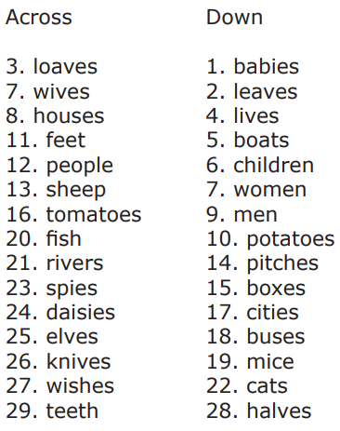
Answers to crossword puzzle:

Slide 14
Countable or uncountable?

Slide 15
Countable or uncountable?
Some words can’t be counted
1 money 2 moneys
1 water 2 waters
1 rice 2 rices
1 advice 2 advices
1 furniture 2 furnitures
the money a money
the advice an advice

Slide 16
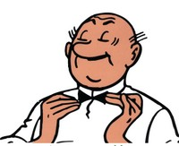
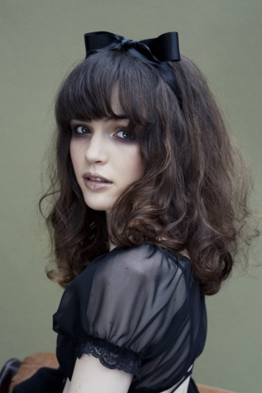
Countable vs. Uncountable: Some nouns can be both
She has a lot of hair
Lambik only has 6
(individual) hairs

Slide 17
How to count them?
Use other words that are units
1 euro 2 euros
Put a unit in front of it
1 glass of water 2 glasses of water
1 plate of rice 2 plates of rice
1 piece of advice 2 pieces of advice
1 piece of furniture 2 pieces of furniture

Slide 18
Which expression of quantity?
Countable
Many (bottles)
Few (bottles)
Fewer (bottles)
(the) fewest (bottles)
Uncountable
Much (water)
Little (water)
Less (water)
(the) least (water)

Slide 19
Compare
Much water, but many bottles of water
Little coffee, but few cups of coffee
Fewer chairs, but less furniture

Slide 20
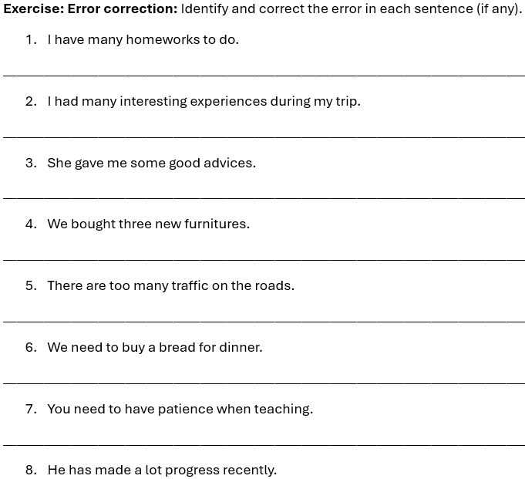

Slide 21
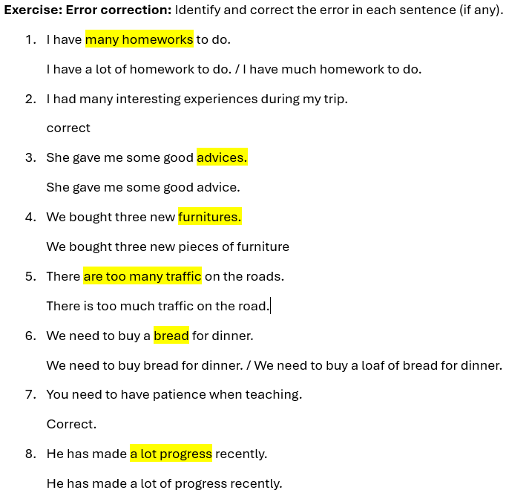

Slide 22
Possession & use of the apostrophe

Slide 23
Rule about forming the possessive with an apostrophe
If you want to make a plural possessive, then first put the word into the plural.
Add an apostrophe ( ’ ) to the end.
Add letter “s” but only if you need it for the sound. (If there is no s- or z-like sound, then you need the “s”)
Boy > boy’s
The boy’s football (the football belong to the boy)
Boys > boys’
The boys’ football (the shared football belonging to the boys)
Men > men’s
Children > children’s

Slide 24
Man > man’s
The man’s hat (the hat belonging to the man)
Men > men’s
The men’s choir (the choir made up of men)
child > child’s
The child’s room (the room belonging to the child)
Children > children’s
The children’s room (the room belonging to the children

Slide 25
How to indicate possession
People/animals: -’s / -’
My sister’s name
The dog’s bone
John’s bike
Also in some other expressions
Yesterday’s paper
At the baker’s [shop]
A winter’s tale
For inanimate objects: the … of …
The name of the book
The roof of the house
The weight of the statue

Slide 26
Dutch Interference
Jan z’n fiets ≠ *John his bike.
De fiets van Jan ≠ *The bike of John.
Jans fiets ≠ *Johns bike
→ John’s bike.

Slide 27
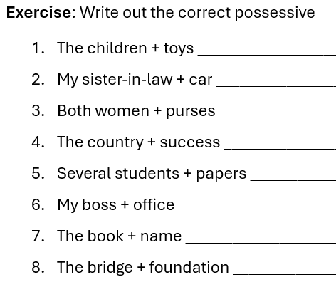
Forming possessives (also on handout)

Slide 28
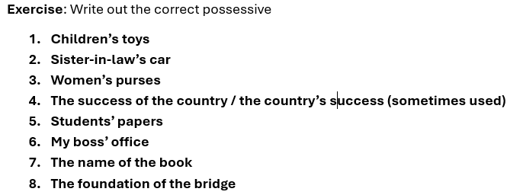
Answers
My boss’s office

Slide 29
Agreement

Slide 30
Singular and Plural Subjects
Measurement phrases take singular verb
Ten miles is too far.
Names referring to one thing take singular verb
The United States has strict laws.
The Netherlands is my country of residence.

Slide 31
Group Nouns
But some group nouns always take plural
Cattle, livestock, people, police and staff
The police are coming to help us
*If you want to refer to one police officer, then you need that word “officer”: e.g.,
“The police officer is coming to help us”
“The police is coming to help us.

Slide 32
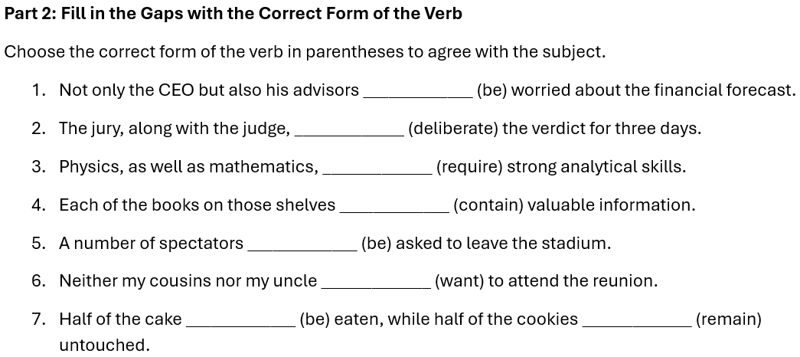
Verb agreement

Slide 33
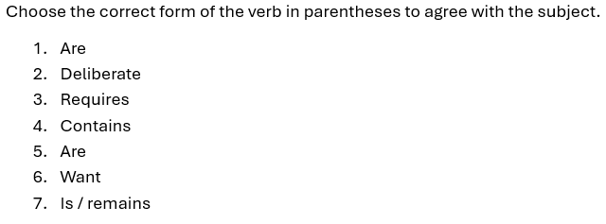
Answers
s

Slide 34
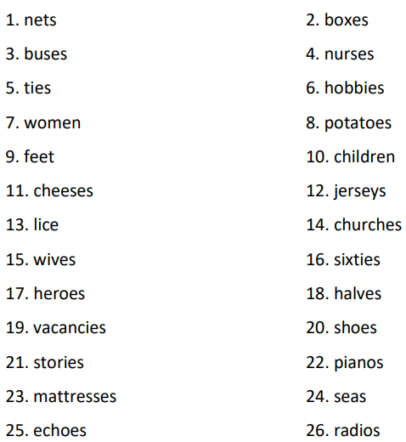
Key: Fill in the correct plural form

Slide 35
